Slide 1
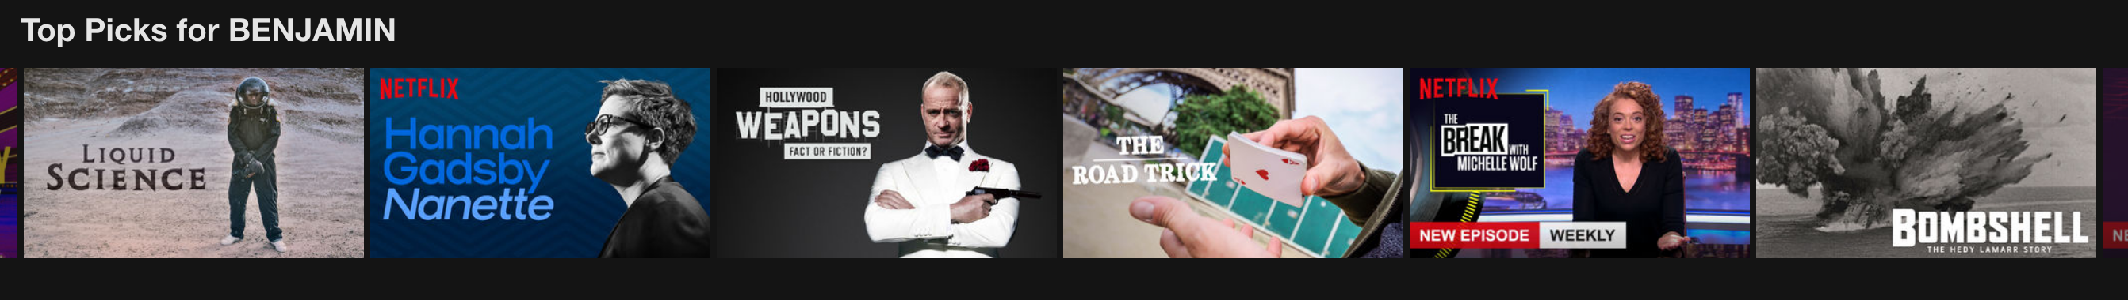
What should we watch tonight?
A Movie Recommender System
Benjamin W. Sturm
June 27, 2018
Notes:
The title of my project is “What should we watch tonight?”: A movie recommender system.

Slide 2
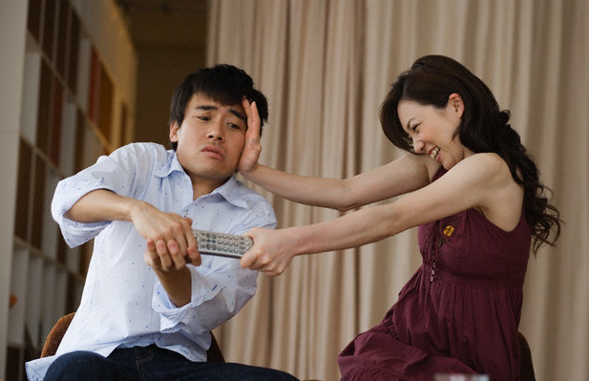
Recommender System Goals
To build a recommender system to take control over the movies I watch
To provide top recommended movies and a predicted score
To be able to make recommendations for couples
Notes:
My goal was to build a movie recommender system that would allow me to take control over the movies I watch and not depend on platforms such as Netflix or Amazon to feed me movie recommendations.
I wanted to provide top recommended movies and a predicted score both for individuals and for couples.
-Click-
Sometimes it can be challenging to come to agreement over what to watch with your loved ones, so I want to try to prevent scenes like this from happening.

Slide 3
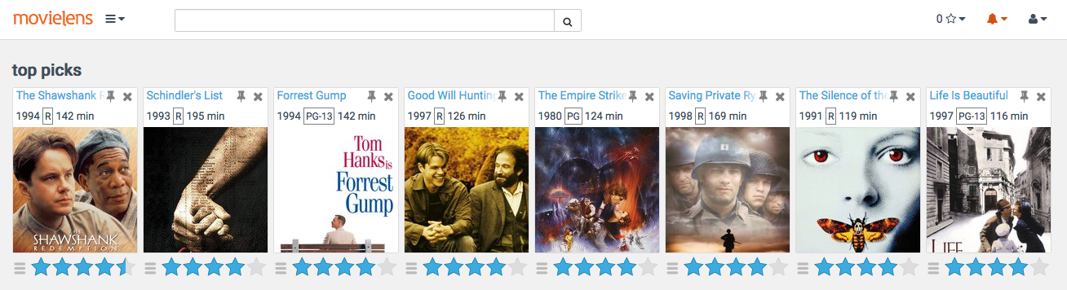
Movie Recommender Data
Employed the MovieLens 20 Million Ratings Dataset
Total number of users: 138,000
Total number of movies: 27,000
Scores range from 0.5 – 5.0
Notes:
For my movie recommender system, I used the MovieLens 20 Million Dataset.
This dataset consists of 20 Million unique ratings from 138,000 users and 27,000 different movies.

Slide 4
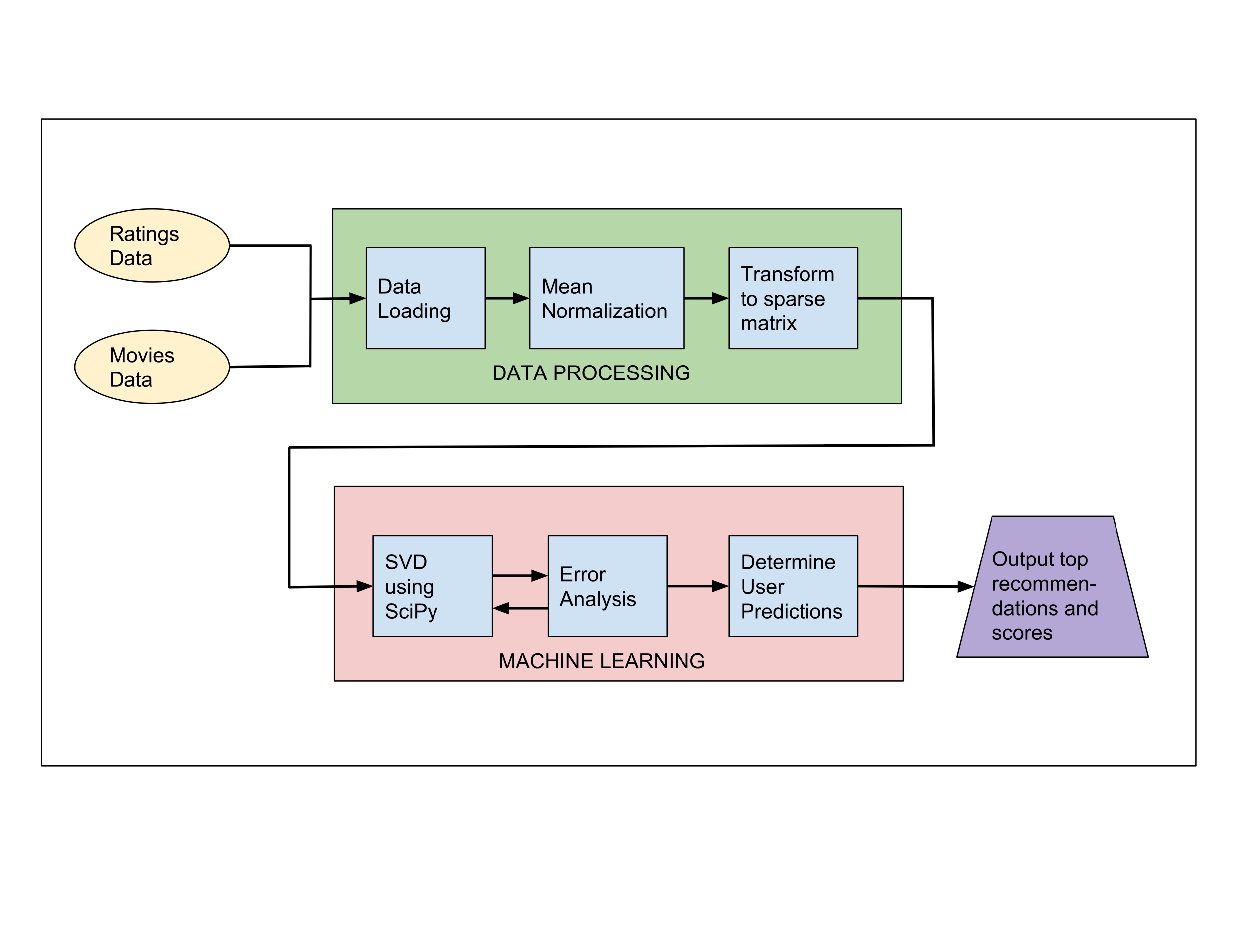
Modeling Approach & Data Pipeline
Implemented a collaborative filtering based recommender
Notes:
I chose to implement a collaborative filtering approach form my movie recommender. Collaborative filtering is a technique to recommend movies to a user based on finding other users with similar tastes.
-Click-

Slide 5
Model Tuning
Tuned my model by adjusting the number of components k
k | Mean Absolute Error | Root Mean Squared Error
100 | 0.744 | 0.958
50 | 0.742 | 0.958
15 | 0.737 | 0.946
P. Cremonesi, R. Turrin, E. Lentini, and M. Matteucci, “An evaluation methodology for recommender systems,” 2008.

Slide 6
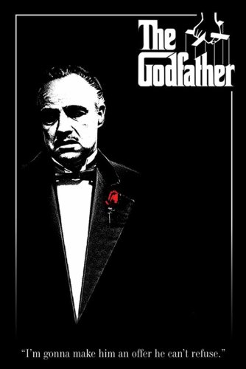









Recommendations for a user that enjoys Thrillers
User Ratings
Movie
Rating | 5.0 | 5.0 | 5.0 | 3.0 | 1.0
Top Recommendations
Movie
PredictedRating | 5.0 | 5.0 | 4.9 | 4.9 | 4.7
Notes:
Now I’d like to discuss some results of my recommender. These results are for a user that enjoys thrillers. This user rated movies such as The Godfather, Hannibal, and Fight Club very high.
-Click-
These are this user’s recommendations and some of the recommendations included Shawshank Redemption, Silence of the Lambs, and Pulp Fiction. So, the recommender appears to be doing a decent job.

Slide 7



Recommendations for Couples
This is a challenging problem due to unique individual preferences
My solution:
Create separate recommendations for each member of the couple
Merge the two lists using a group rating function R_{G}
$$R_{G}=\left(\frac{R_{1}{+R}_{2}}{2}\right)−\left(\frac{\left|R_{1}−R_{2}\right|}{5}\right)$$
R_{User1}
5.0
4.2
R_{User2}
3.0
3.8
R_{avg}
4.0
4.0
R_{G}
3.6
3.92
Notes:
One of the main goals I wanted to achieve for my project was to build a robust recommender that also works for couples. This is a challenging problem due to the fact that a recommender has to treat the couple as almost a single user with dual personalities.
My solution for this problem was to:
Create separate recommendations for each member of the couple
Merge the two lists using a group rating function. This group rating function calculates the average predicted score minus a penalty term that is proportional to the difference of the two ratings.
-Click-
So for a movie like Pi, User1 and User2 might have dissimilar predicted scores. The average score is 4.0 and the group rating score is 3.6.
For A Beautiful Mind, the predcited scores might be similar. The average score is still 4.0, but the group rating is now 3.92, since the different is small.

Slide 8





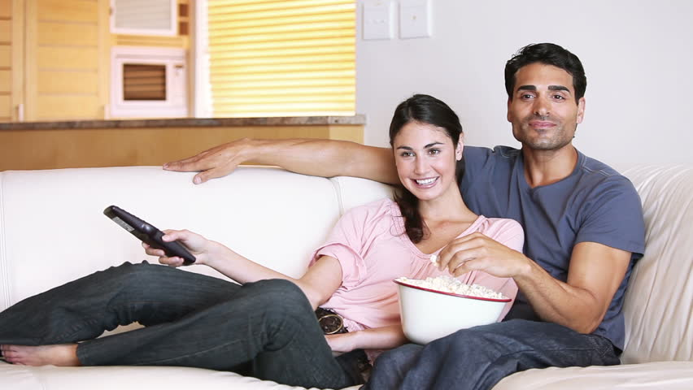
Recommendations for my better half and I
Top Picks or Us
Movie
Rating | 4.5 | 4.3 | 4.3 | 4.5 | 4.3 | 4.3
Notes:
I tested my movie recommender for couples on my better half and I and the results helped to provide confirmation of my model. Namely, many of the movies recommended were ones we have already seen and also really liked. –Click- There were definitely some new ones in there, so I’m excited to check those out as well. -Click-
My hope is that my recommender will help to avoid confrontation and lead to happy movie watching.

Slide 9
Outlook for Future Work
Do topic modeling on movie tags dataset
Incorporate topic data into a hybrid model
Build a web app
Notes:
There are many ways that I would like to extend this work in the future.
For starters, I would make use of another dataset that has user specified tags for each movie and do some topic modeling on these tags.
With these topics, I could then incorporate some content-based features in order to build a hybrid model.
Lastly, I would like to build a web application (likely with Flask) to allow anybody who is interested to upload their own unique ratings and see their list of recommended movies.

Slide 10

Thank you!
Benjamin W. Sturm, Ph.D.
email: bwsturm@gmail.com
LinkedIn: bwsturm
Github: bwsturm

Slide 11
Appendix: SVD description
movies
k
Movie Ratings
matrix
User matrix
k
movies
=
·
weights
·
Movies
matrix
users
users
k
k
SVD is a powerful technique to achieve dimensionality reduction on a large matrix.
We can reduce a matrix with a large number of features to one with a smaller subset of features that allows us to approximate the original matrix
Notes:
To build my collaborative filtering model, I used singular value decomposition or SVD.
SVD is a technique to do matrix factorization in order to decompose a matrix into three smaller matrices with very specific properties.
One of the free parameters in SVD is k, which corresponds to the number of components. By adjusting k, we can reduce the number of components used to describe a matrix to one with a lower rank. This technique allows us to approximate our original matrix to one with fewer features.

Slide 12










Recommendations for a user that enjoys Rom Coms
User Ratings
Movie
Rating | 5.0 | 5.0 | 5.0 | 1.0 | 1.0
Top Recommendations
Movie
PredictedRating | 4.3 | 4.3 | 4.3 | 4.2 | 4.2

Slide 13
Outline
Goals
Data Description
Data Pipeline / Model Tuning
Results for Single User
Results for Couple
Summary/Outlook

